Slide 1
Lab #5: Jaccard similarity
In this lab assignment you will write set of functions to compute Jaccard similarity between genomes based on comparison of their fixed size sketches. Due November 10th at 8:00pm
The goal is to write a Python script named jaccard.py containing the following functions:
  reverse_complement(seq): returns reverse complement of sequence seq; reuse this function from Lab #2.
  compute_num_value (seq): returns minimum numerical value between forward and reverse versions of the sequence seq; reuse this function from Lab #2.
  (G:30pt,U:30pt) load_fasta_to_dict(fasta_path): parses fasta file fasta_path and returns a dictionary where keys are names of fasta sequences, and values are the genome sequences
  (G:30pt,U:30pt) compute_sketch(seq_dict,k,s): returns a sketch, which is an array of s smallest distinct integer k-mer values sorted from smallest to largest for all k-mers of size k in all genome sequences in seq_dict
  (G:30pt,U:40pt) compare_sketches(sketch1,sketch2,s): computes Jaccard similarity for sketches sketch1 and sketch2 of size s, returns a floating-point number between 0 and 1.
Graduate students only: (10pt) download two HIV virus sequences from NCBI: accessions GCA_003109165.1 and GCA_003109225.1; use s=20, vary K from 6 to 101, plot Jaccard(K,s). At what value of K Jaccard similarity becomes equal to 0? Upload a figure containing plot of Jaccard(K,s) as function of K. Add a box with value of K’ where Jaccard (K,20)’==0

Slide 2
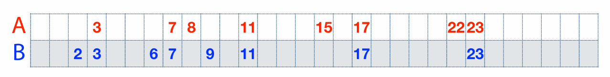
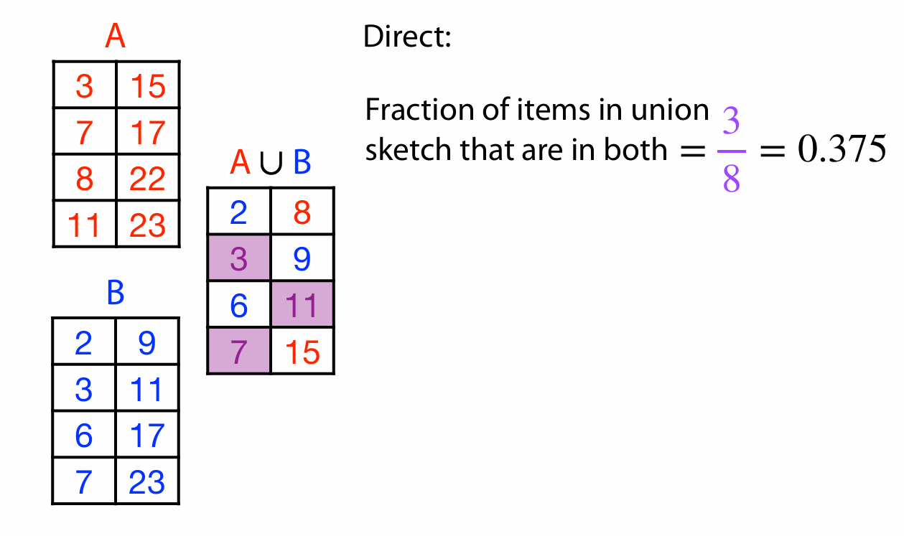
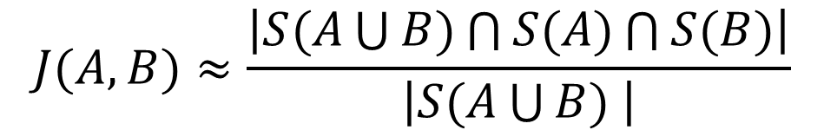



Jaccard similarity example
$$S(A)$$
$$S(A\bigcup{B)}$$
$$S(B)$$
$$J(A,B)≈\frac{\left|S(A\bigcup{B)\bigcap{S(A)}\bigcap{S(B)}}\right|}{\left|S(A\bigcup{B) }\right|}$$

Slide 3
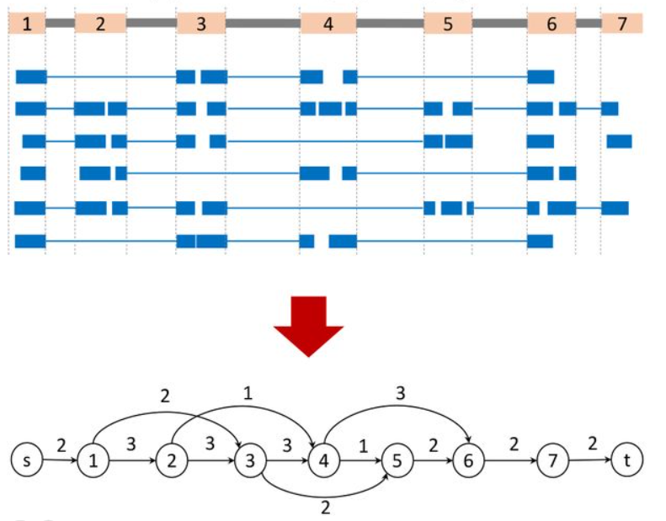
Assembly of aligned RNA-seq data
Image credit: https://www.biorxiv.org/content/10.1101/2024.02.09.579380v1.full
Use spliced alignments
Typically faster and more accurate
Build splice graph:
  Nodes are exons
  Edges are introns
  Edge weight is the number of spliced reads
Remember that these data represent several linear transcripts

Slide 4
Assembly of aligned RNA-seq data
Image credit: https://www.biorxiv.org/content/10.1101/2024.02.09.579380v1.full
Can be solved as a variant of maximum flow problem
The problem: distribute paths(flows) between several linear transcripts
Algorithm:
  Compute the path of heaviest coverage
  Remove the reads used in the path
  iterate

Slide 5
Assembly of aligned RNA-seq data
Image credit: https://www.biorxiv.org/content/10.1101/2024.02.09.579380v1.full
Path: 1-2-3-4-6 f=3

Slide 6
Assembly of aligned RNA-seq data
Image credit: https://www.biorxiv.org/content/10.1101/2024.02.09.579380v1.full
Path: 1-2-3-4-6 f=3
Remove reads used in the first path
Second path:1-3-5-6-7 f=2

Slide 7
Assembly of aligned RNA-seq data
Image credit: https://www.biorxiv.org/content/10.1101/2024.02.09.579380v1.full
Path: 1-2-3-4-6-7 f=3
Remove reads used in the first path
Second path:1-3-5 f=2
Remove reads used in the second path
Third path: 2-4-5 f=1

Slide 8
Evaluating transcript assembly
We want to compare the assembly output against a benchmark transcriptome where correct sequences of all transcripts are known.
Limitations of using a known reference transcriptome:
variability in the transcriptome (e.g. among e.g. cell types) makes it impossible to determine whether sequences from the reference that are missing from the assembled transcriptome are due to assembly errors, or whether they were not expressed in the library sequenced
transcriptome sequences may also vary between the individual under study and the reference

